Slide 1
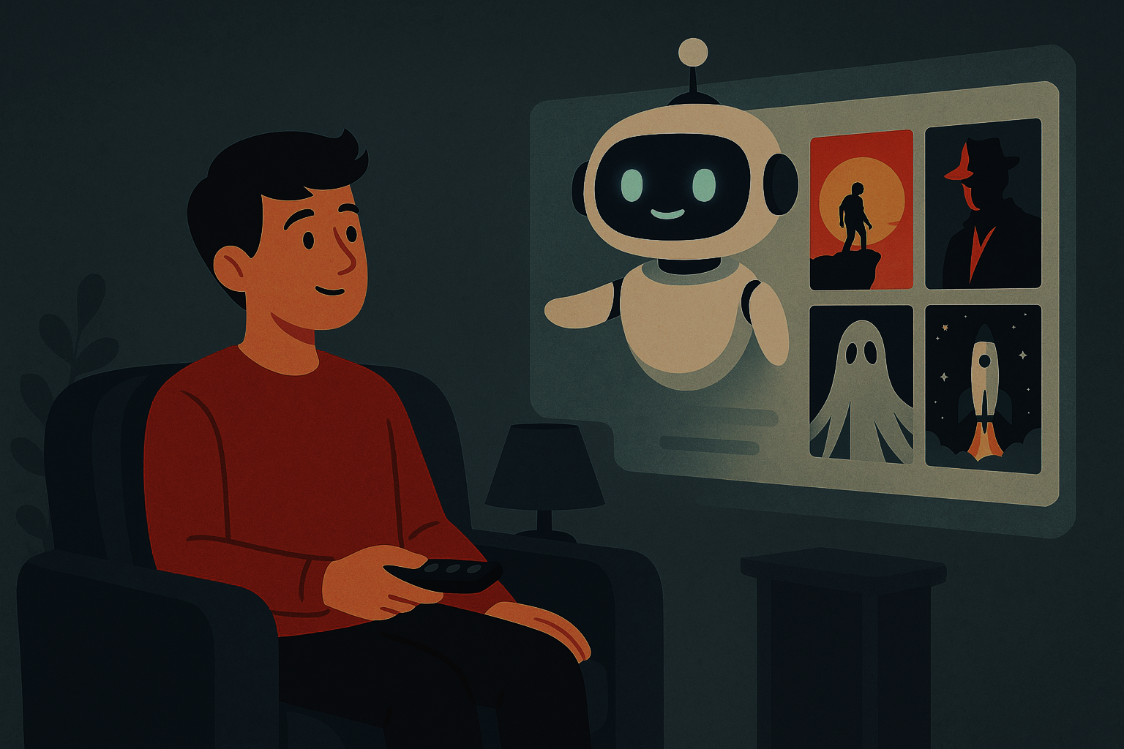

Movie Recommender system
COMPUTER
ENGINEERING
By:
Amr Edris, 22-101097
Mourad El-Shorbagy, 22-101026
Youssef Haytham, 22-101229

Slide 2





Table of Content
Problem
Approach
Methodology
Results
Challenges

Slide 3
Table of Contents
Introduction
What are Recommender Systems
Types of Recommender Systems
Data
Cleaning and Preprocessing
Model
GMF Model
MLP Model
NeuMF Model
Design & Justification
Performance Analysis
Challenges

Slide 4

Problem
We often make big decisions like our careers with little guidance, but when it comes to small things like picking lunch or a movie, we overthink, scroll endlessly, compare ratings, read reviews…
New study by UserTesting reveals the average person wastes 110 hours a year scrolling through streaming apps trying to find something to watch.
That’s where recommender systems come in to reduce decision fatigue, save time, and provide personalized suggestions based on our preferences and behavior

Slide 5

What Are Recommender Systems?
Recommender systems are algorithms that suggest items to users based on various types of data.
Commonly used in streaming platforms, e-commerce, and social media to enhance user experience.
Aim to reduce decision fatigue and improve engagement by personalizing suggestions.
Two major approaches: collaborative filtering and content-based filtering, often combined in hybrid models.

Slide 6
Why Personalized Recommendations Matter
Streaming platforms host thousands of titles, making manual selection impractical.
Personalized suggestions help users quickly discover relevant movies.
Improved recommendations increase user engagement and platform loyalty.
Businesses benefit from longer watch times and better customer retention

Slide 7

Collaborative Filtering
Based on the idea that users with similar preferences will like similar items.
User-based: Recommends items liked by users with similar tastes.
Item-based: Recommends items that are like those the user has already liked.
Requires user-item interaction data (e.g., ratings).
Strength: Can discover unexpected preferences.
Limitation: Suffers from cold start and sparsity issues.

Slide 8
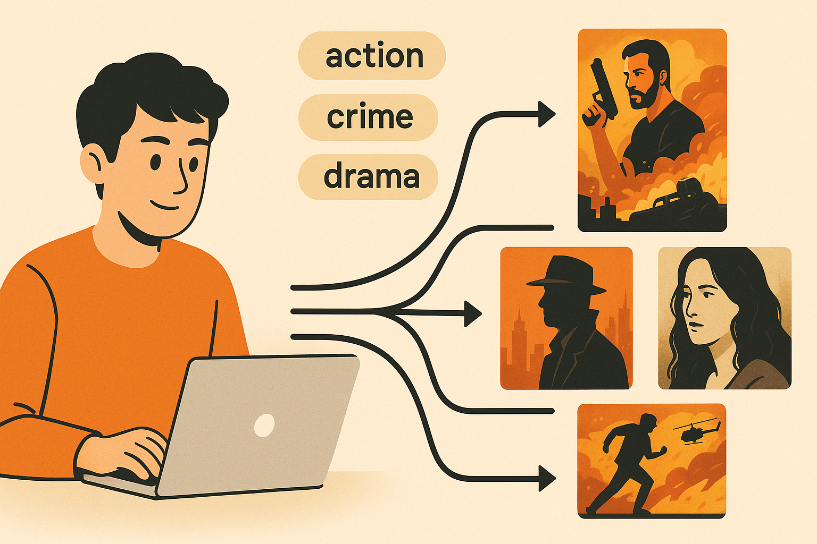
Content-Based Filtering
Recommends items based on the features of the items and the user’s history.
Uses metadata such as genre, actors, director, and other attributes.
Builds a profile of the user’s preferences and matches it with similar content.
Strength: Effective for new users with little interaction data.
Limitation: Can lead to a lack of diversity (“more of the same” problem).

Slide 9
Hybrid Recommender Systems
Combine collaborative and content-based filtering to leverage strengths of both.
Address weaknesses like cold start and over-specialization.
Can be implemented via model blending, feature augmentation, or neural networks.
Provide more balanced, accurate, and diverse recommendations.

Slide 10
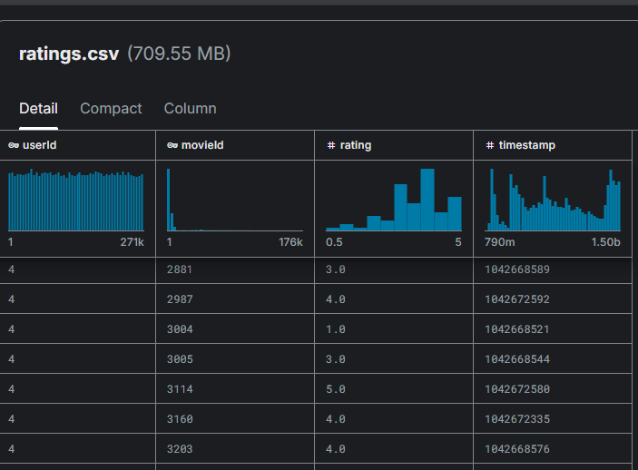
Movielens – 1m Dataset (Kaggle)
This dataset includes comprehensive metadata on over 3900 Movies.
Contains 1 million ratings from over 6,000 users.
Ratings were made on a 5-star scale
Ideal for building recommender systems due to its scale and rich feature set.

Slide 11

Data Cleaning and Preprocessing
Irrelevant columns such as timestamp were removed to simplify the dataset.
Examined and confirmed to be free of missing values
Data was split into training and test sets to evaluate performance accurately.
User and movie identifiers were numerically encoded to prepare the data for machine learning models.

Slide 12
Paper-Neural Collaborative Filtering – He et al. (2017)
Objective of the Paper:
Improve collaborative filtering using neural networks
Replace traditional matrix factorization with learnable non-linear functions
Key Contributions:
Proposed a Neural Collaborative Filtering (NCF) framework
Used GMF, MLP, and introduced the NeuMF hybrid model
Demonstrated superior performance on benchmark datasets
Why It’s Relevant to Our Project:
Foundation for our hybrid recommender architecture
Inspired our model design and experimentation strategy

Slide 13
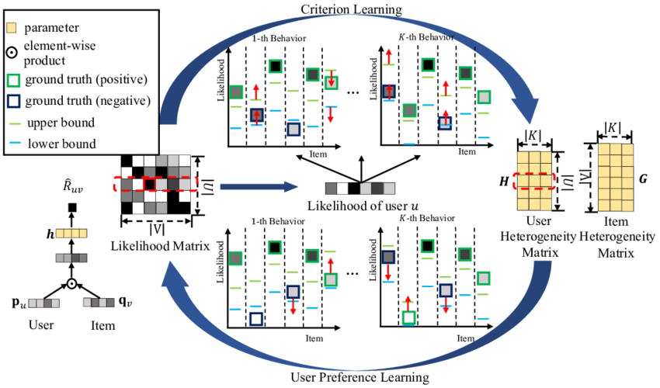
GMF Model (Generalized Matrix Factorization)
User and Item IDs are used as Inputs
Embeddings are made for users and items. These are the parameters that get trained.
A latent vector is calculated using element-wise multiplication of User and Item Vectors.
The Latent Vector is then fed to an output neuron, which computes the score
The Embeddings are Flattened to get user and item vectors
Serves as the linear component in the NeuMF hybrid model

Slide 14
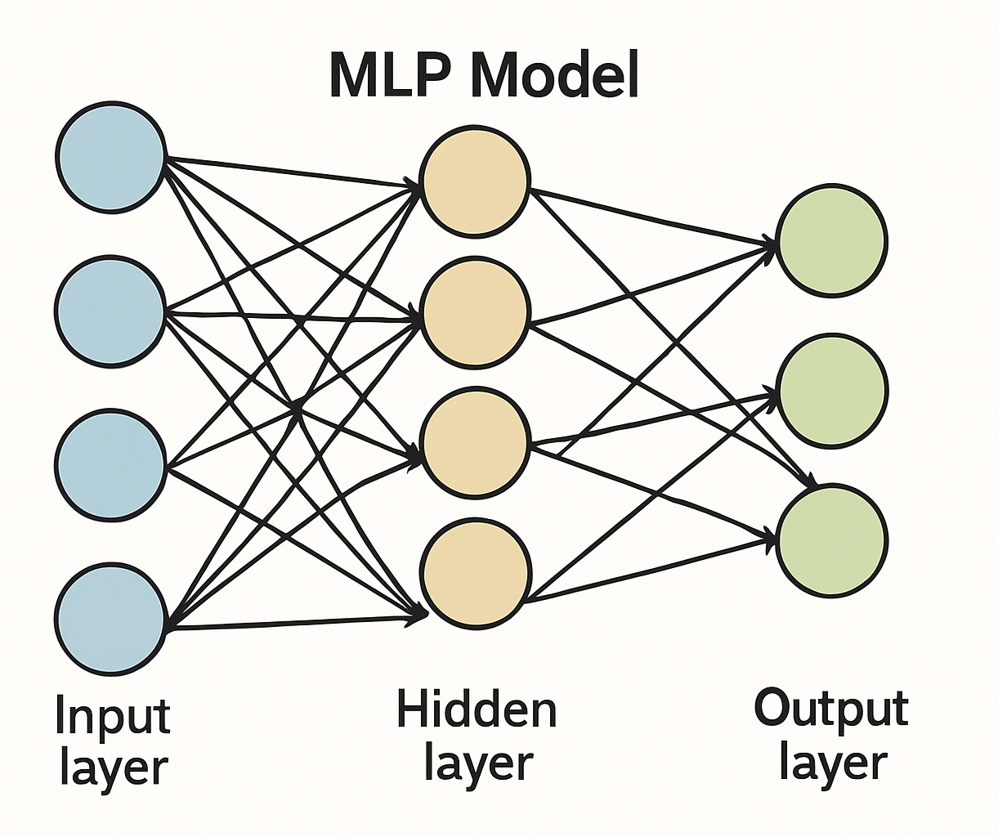
MLP Model (Multi-Layer Perceptron)
User and Item IDs are used as Inputs
Embeddings are made for users and items. These are the parameters that get trained.
A latent vector is calculated by concatenating the User and Item Vectors.
The Latent Vector is then fed to multi-layer Perceptron, which computes the score
The Embeddings are Flattened to get user and item vectors
Serves as the the non-linear component in the NeuMF hybrid model

Slide 15
NeuMF Model (Neural Matrix Factorization)
Combines strengths of GMF (linear) and MLP (non-linear) models
Parallel paths: GMF captures latent interactions, MLP models complex patterns
Outputs from both branches are merged and passed to a final layer
Joint training improves overall recommendation accuracy
Shows better validation performance than GMF or MLP alone

Slide 16
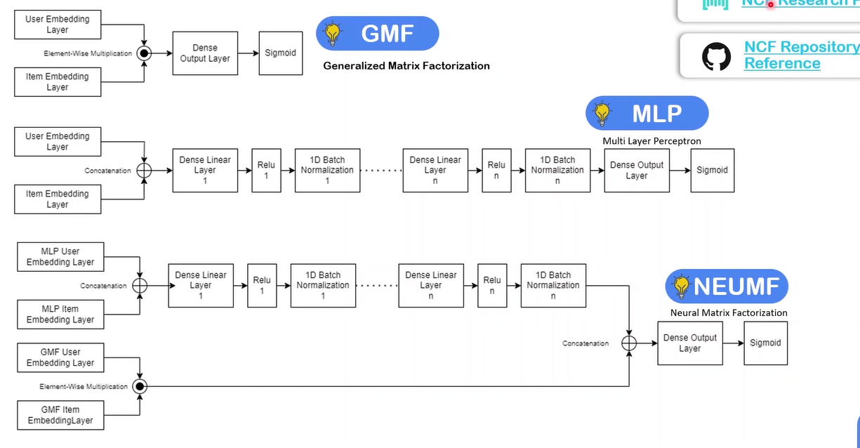
NeuMF Model (Neural Matrix Factorization)
Linear
Linear
Linear

Slide 17
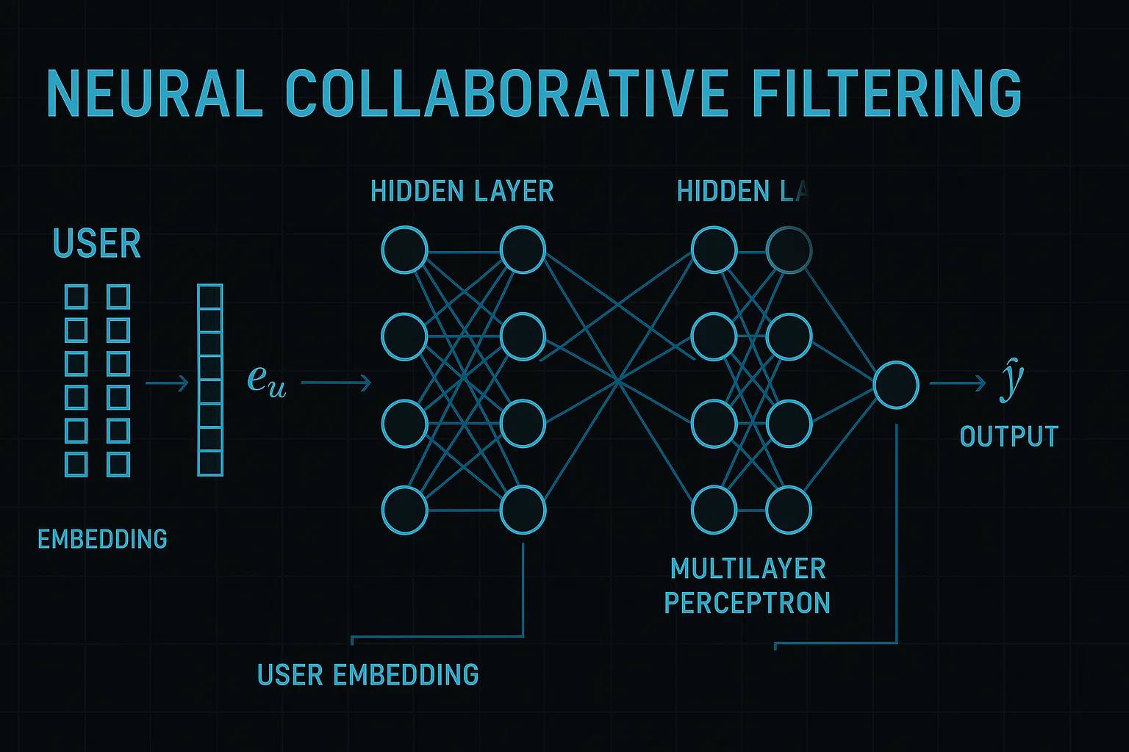
Model Design & Justification
Why NeuMF?
Captures complex user-item interactions
GMF: Learns Linear Patterns
MLP: Learns Non-Linear Patterns
NeuMF: Combines strengths of GMF + MLP
Justification for Model Choice:
Flexibility and scalability
Strong theoretical foundation
Proven performance in the original paper

Slide 18
Performance Analysis
Evaluation
GMF and MLP performed well independently
NeuMF achieved the best validation accuracy
The model could be used to suggest diverse but relevant movies
Metrics
Results:
MAE: 0.6815
MAE (Mean Absolute Error): How much our prediction are off by
MSE (Mean Squared Error: Focuses more on larger errors
MSE: 0.7543

Slide 19
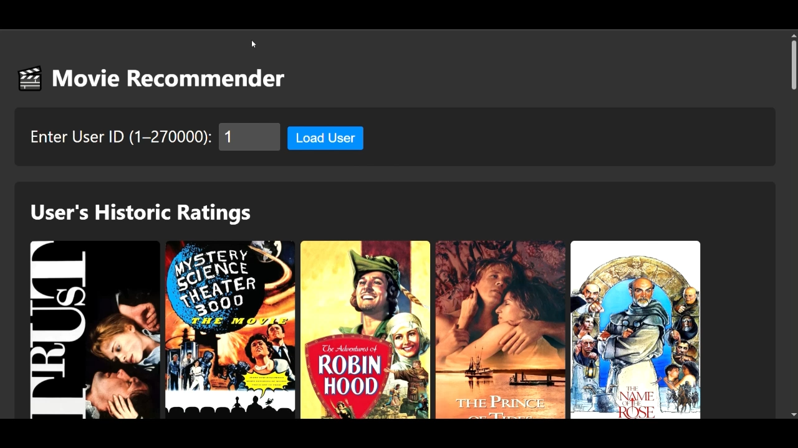
Visualizing Results
Baseline Model: Guessing the mean rating of all users has the following scores:
MAE: 0.9360
MSE: 1.2538 (Variance)
Video Demo:

Slide 20
Challenges
Data sparsity: Limited user ratings make it hard to learn accurate preferences, especially for new users.
Cold start problem: Recommending for new users or new movies without historical data remains difficult.
Overfitting: Our NeuMF model was heavily prone to overfitting. We tried many regularization techniques to try and alleviate this issue.
Model complexity: Training deep learning models requires substantial computational resources and fine-tuning.

Slide 21


